Slide 1

AssurPharma
Technical Meeting
« Proof of Concept »
Wednesday 22/10/2014
WIFI
SSID = APB_PUBLIC
PASSW = 0penw1f1

Slide 2
Program of the day
Configuration + use of the SDK Executor Tool (version 1.4.0)
Perform E2E tests in Acceptance Environment
Q&A
Working meeting!
Questions, ideas, suggestions, …
are welcome at any time

Slide 3
Use of the SDK Executor Tool

Request eHealth test Certificates (pharmacy + pharmacist)
Installation of the SDK Executor GUI tool
Configuration
    Copy eHealth certificates (.acc-p12) in folder conf\p12\acc
    Open file conf\connector-client.properties with text-editor


Slide 4
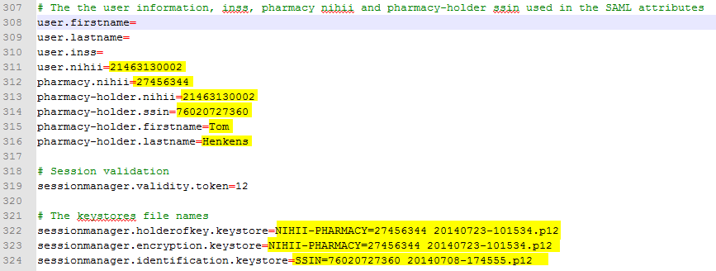
Use of the SDK Executor Tool
Pharmacy N° | Pharmacy Name | Pharmacy holder SSIN | Pharmacy holder N° NIHII | Pharmacy holder Name | Pharmacy holder last name
29900348 | APO ASSU 0739 | 84020732579 | 22070171001 | Pieterjan | Vanpee
29900447 | APO ASSU 0079 | 69021010390 | 22070468001 | Karl | Vandecasteele
29900546 | APO ASSU 0196 | 74101902361 | 22070369001 | Thierry | Bertholet

Slide 5
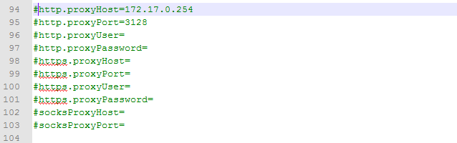
Use of the SDK Executor Tool
Proxy configuration (only if necessary)
Run SDK GUI (examples\gui\startGui.bat

Slide 6
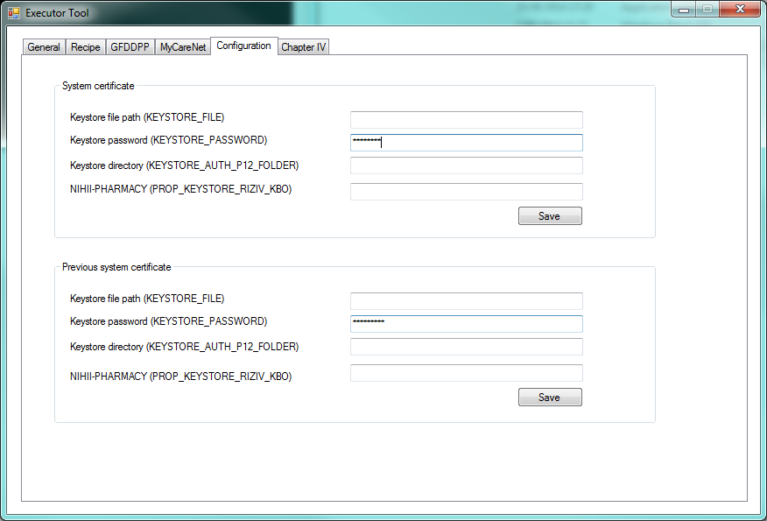
Use of the SDK Executor Tool
Tab “Configuration”
Pharmacy certificate PWD

Slide 7
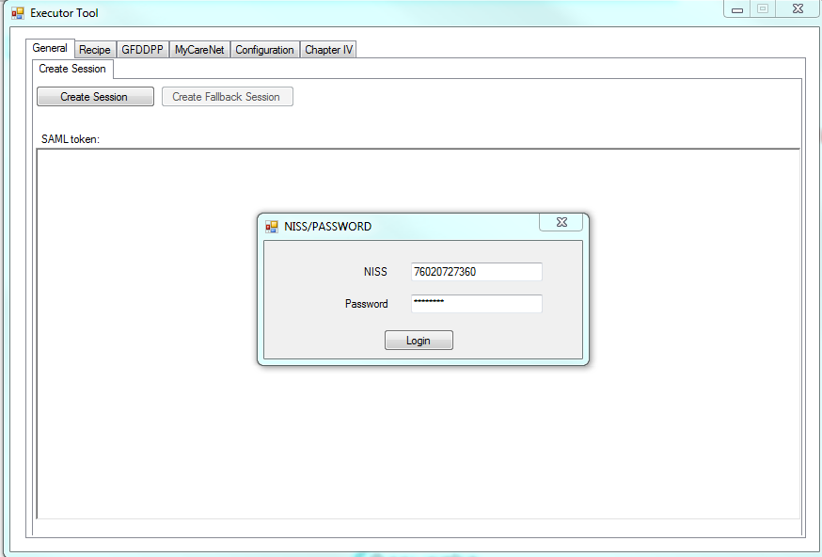
Use of the SDK Executor Tool
Tab “General”
Personal certificate PWD

Slide 8
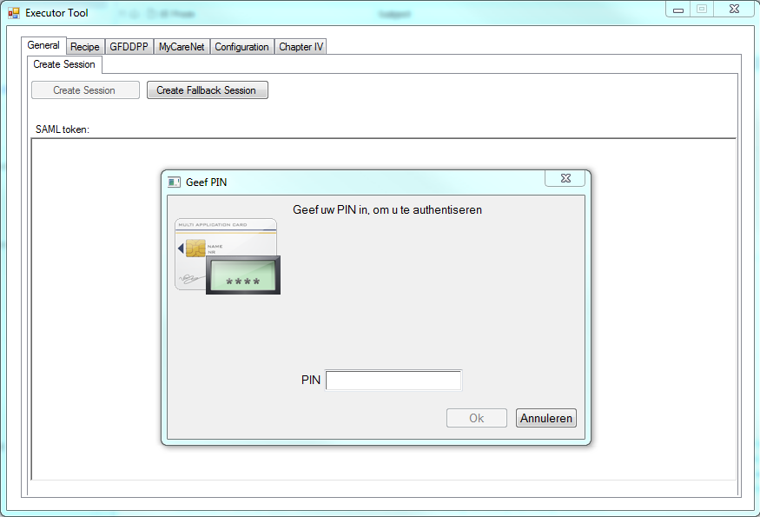
Use of the SDK Executor Tool
Tab “General”
eID pincode

Slide 9
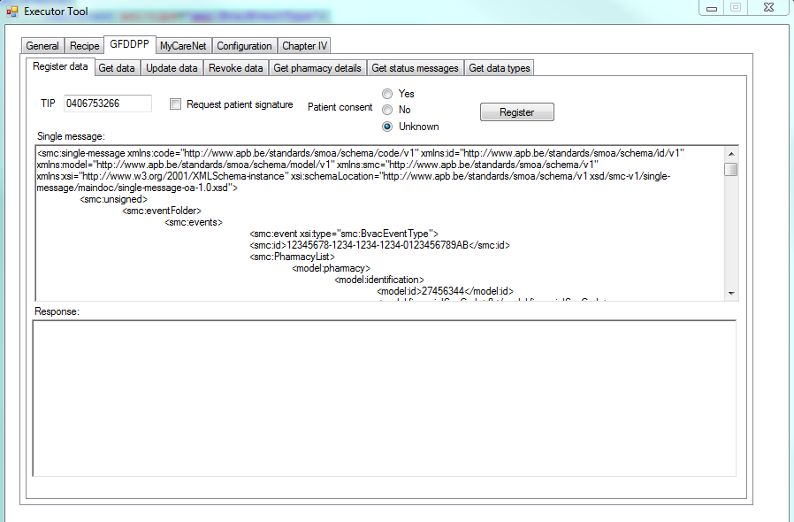
Use of the SDK Executor Tool
Tab “GFDDPP”
    Tab “Register data”
Paste BVAC XML.
Don’t forget to use your own pharmacy number

Slide 10
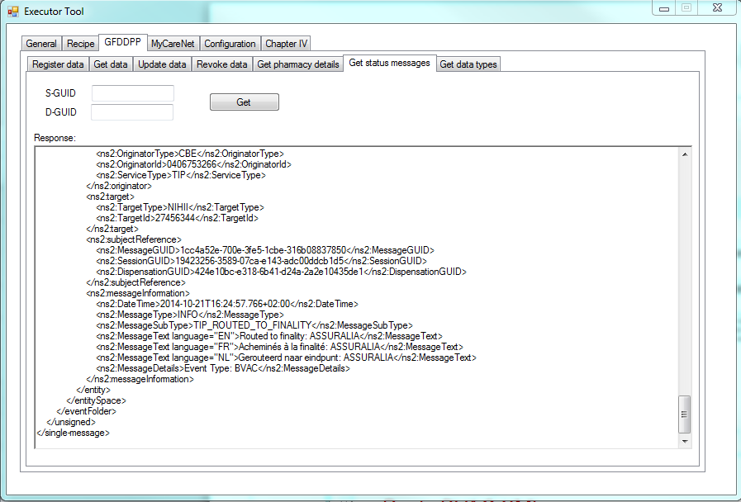
Use of the SDK Executor Tool
Tab “GFDDPP”
    Tab “Get status messages”
Regularly poll for status messages

Slide 11
E2E Testing
+
Questions and Answers

